Slide 1
Applied Machine Learning in Data Processing
Data Analyst Intern: Deevanshu Khatri
Data Development August 2023
Notes:
Good afternoon everyone. Hope you are having a good day. I would be presenting my findings on applying machine learning on the stops process

Slide 2



Overview on Stops and current process
Stop Optimization refers to the set of rules that prevent a file from getting processed
These rules are in place to ensure data integrity and prevent errors from propagating through the analysis pipeline
Currently there are two major category of rules that are in place:
Rules based on Business Acumen:
IF CII M GREATER THAN @MIN@ AND GREATER THAN @VALUE@% OF BASE SEGMENT THEN STOP
IF STATUS 78 GREATER THAN @MIN@ AND GREATER THAN @VALUE@% OF BASE SEGMENT R=THEN STOP
Rules based on Statistics:
IF TRANSACTIONS REJECTED VARY HISTORICALLY MORE THAN @VALUE@ STANDARD DEVIATIONS FROM HISTORICAL MEAN OF RATIO TO COMPLEX IN FOR THE PREVIOUS SUBMISSION THEN STOP
2 © Experian 8/4/2023 Experian Confidential
Notes:
Stops is basically preventing a file from getting processed which helps in preventing the incorrect or inaccurate data to get processed. While I was exploring the current rules, I observed that there are briefly two sets of rules, the first rules being based on the business knowledge and understanding. For ex:
The second set are the rules based on the statistics of the data. For Ex:

Slide 3
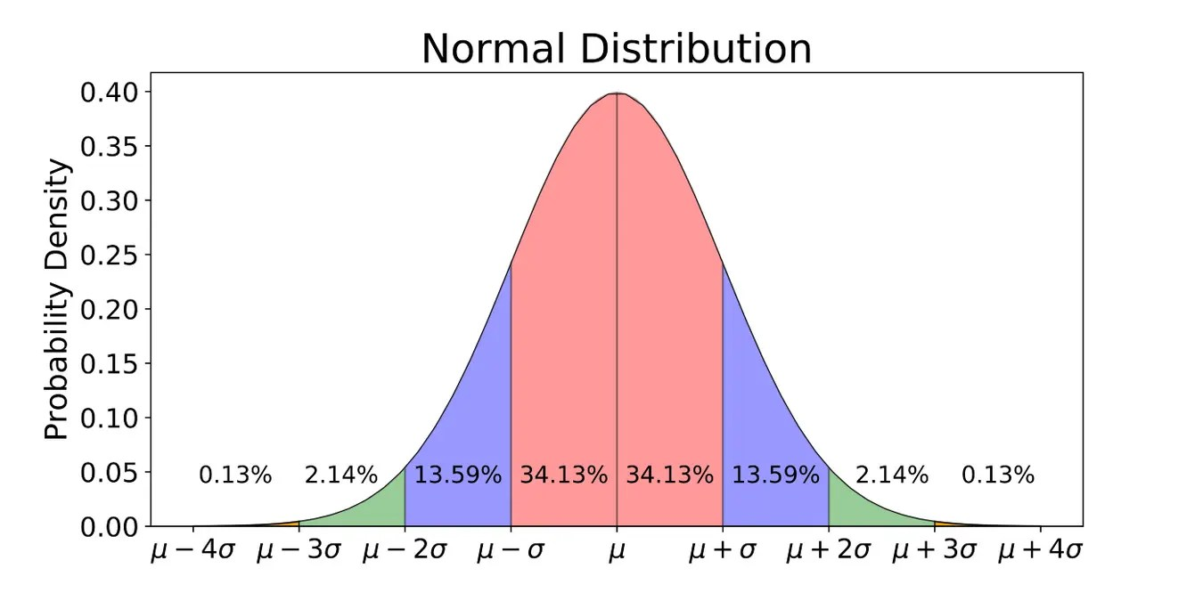
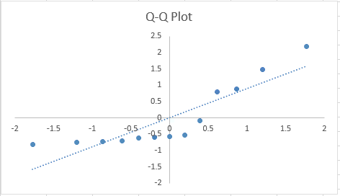
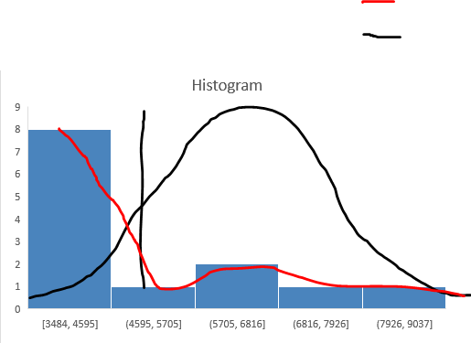
Current Process - Statistic Rules using Standard Deviation
Key assumption of the statistical rules is that the data is normally distributed
The current rules identify outliers in different features like Transactions rejected, Implied key changes, etc.
The criteria is very loose with data points above and below 3.5 – 4 standard deviations away from the mean
Up to 99% variation is considered acceptable when data is normally distributed
From the graphs provided – we observe that the data is not normally distributed and likely contributes to a high number of files being stopped unnecessarily.
Actual Distribution
Assumed Distribution
Mean: 4980
Frequency
3 © Experian 8/4/2023 Experian Confidential
Base segment in Total
Notes:
I started looking at the statistical rules and found out that the key assumption on the rules is that the data follows a normal distribution. A normal distribution assumes that any data within 3 standard deviation of the mean on both the sides has ~99% probability that the data is not an outlier. But when I looked at the distribution of the data, it clearly demonstrates that the data is not at all normally distributed. To confirm this I plotted a QQ graph which is nothing but a graph to check if the data is normally distributed or not and it proved that it is not because if the data points in the QQ plot the near the data points to the trend line the more is the data being normally distributed. and detecting outliers with this approach is a very naïve approach as getting a normally distributed data in real world scenario is very rare. Explain histogram graph

Slide 4
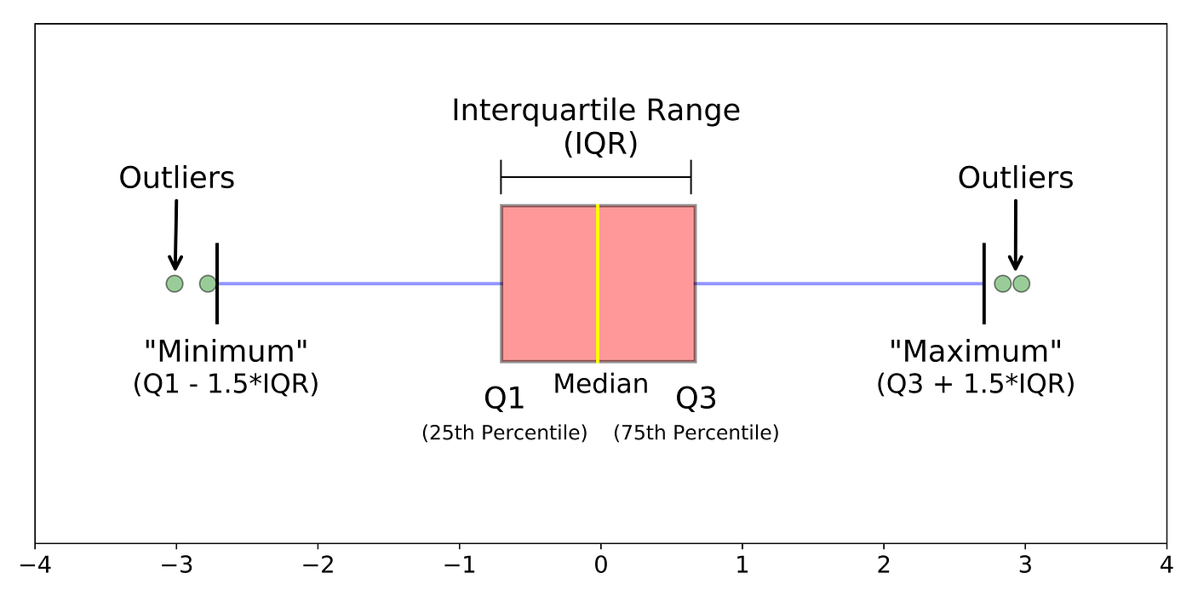
Future Process - Outlier detection using Interquartile Range (IQR)
For skewed data, IQR method works well to detect outliers
IQR standard cut off is 1.5
similar performance as current 3.5 - 4 Standard Deviation
Loosening the cut off to 3
Estimated 50% reduction in stopped files
For these initial results we have used three metrics for VINs ANLE and AUPS
Base Segment Total, Payment History Profile Total, and Records Sent to Simple
Notes:
A more robust way to detect outliers in the data is to use the technique of Interquartile range. Instead of mean that is very much affected by the outliers, IQR method uses median which is robust to handle outliers. Explain the graph.

Slide 5


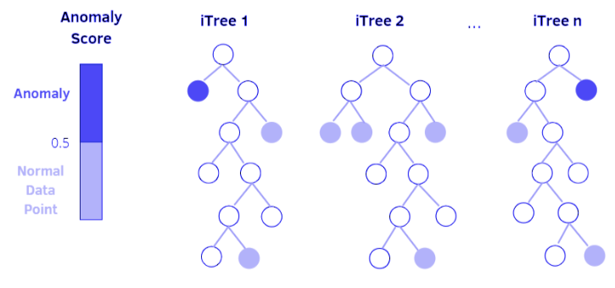
Machine Learning based approach
We can identify this problem as one class classification
There are multiple one class classifiers that can be used – One Class SVM, Isolation forest, etc.
Since we have small history available (~11 months of data) tree-based classifier will work best
Using Isolation Forest with all the nonzero columns of the tables DATA_VAL_SUM_STAT and DATA_VAL_TOT_STAT and using standard configuration we see an improvement of ~12%
Hyper-parameter tuning and feature engineering would help in further improvement of the classifier
Reject File
Error File
Discard File
Raw Metro 2 Data
5 © Experian 8/4/2023 Experian Confidential
Notes:
This problem in machine learning is the problem of one class classification as the number of files that actually needs to stop is very less as compared to the number of files that does not needs to be stopped. So after researching on various one class classifiers like SVM, neural network based models, tree based models, tree based classifiers works the best with data have less history and more metrics. Isolation forest is a tree based classifier that generates 100 tress and each tree classifies whether the incoming file is an anomaly or outlier and the decision of majority of trees is selected as the final decision. the first cut result showed an improvement of 12% for the files being stopped. We will need to perform testing on more data to confirm this fact but ~ 10% improvement is expected. Currently I have used almost all the non zero columns of the data_val_sum_stat and data_val_tot_stat tables with standard parameters of the classifier.

Slide 6
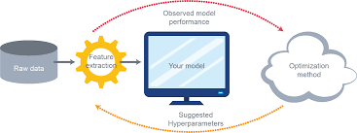
Next Steps
Perform hyper-parameter tuning and feature engineering to improve the isolation forest model
Contamination
Number of Trees
Perform analysis on the historical data and iteratively test the model with different parameters
NOTE: Approach is a black box. A system would need to be on top of this to provide approximation on why the file is stopping
Further development could create an ensemble model to incorporate both business rules as well as machine learning
6 © Experian 8/4/2023 Experian Confidential
Notes:
Next steps to further improve the files that needs to be stopped are: Perform hyper parameter tuning of the isolation forest. Max_samples, contamination, number of trees, we need to tune these parameters as per our needs to get best results. This is an iterative process and increasing the number of testing would significantly help us in improving the accuracy. One note: As most of the Machine learning algorithms are black box as in we will not get the reason of why the file is being stopped and it would be important for the business as well as model improvement to understand the reason, we will need to pass the stopped files to an algorithm (that we would need to create using business inputs) to approximate the reason of stoppage. A more robust approach would be to create an ensemble system that will incorporate both business rules as well as isolation forest.

Slide 7
7 © Experian 8/4/2023 Experian Confidential

Slide 8
Appendix
There are two python codes names IQR.ipynp and isolation_forest.ipynb with implementation of both the methodologies which are reusable and with all the necessary comments
One PPT named Machine Learning in Data Processing
Location on the remote server: F:\DD_DPM\Team\DK\Ttemplate Threshold Validation\documents
8 © Experian 8/4/2023 Experian Confidential

